Slide 1
Chapter 2 Objectives
The CCNA Topics Covered in this chapter include:
  HDLC
  PPP

Slide 2
HDLC Protocol
Bit-oriented Data Link layer ISO standard protocol
Specifies a data encapsulation method
No authentication can be used

Slide 3
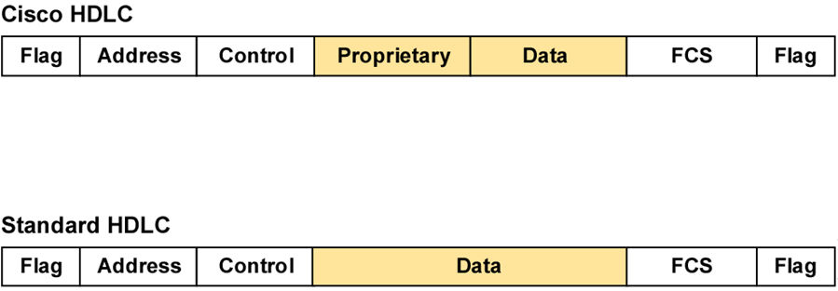
HDLC Frame Format
Uses a proprietary data field to support multiprotocol environments
Supports only single-protocol environments

Slide 4
Configuring HDLC Encapsulation
Router(config-if)#encapsulation hdlc
Enables HDLC encapsulation
Uses the default encapsulation on synchronous serial interfaces

Slide 5
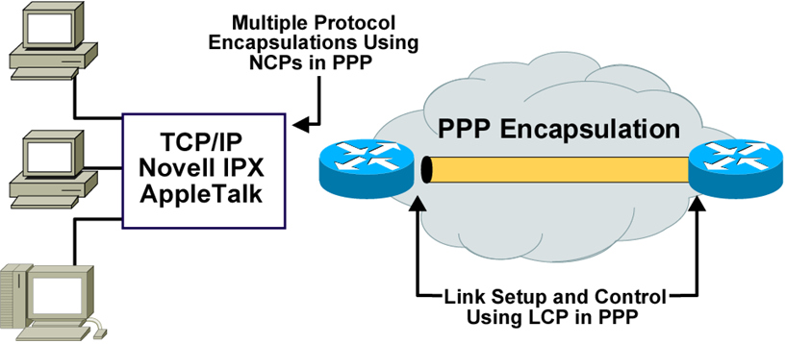
An Overview of PPP
PPP can carry packets from several protocol suites using NCP.
PPP controls the setup of several link options using LCP.

Slide 6
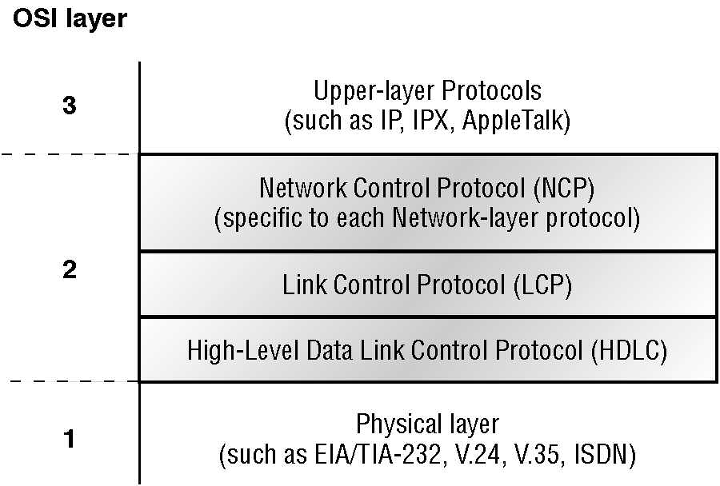
Point-to-Point Protocol Stack

Slide 7
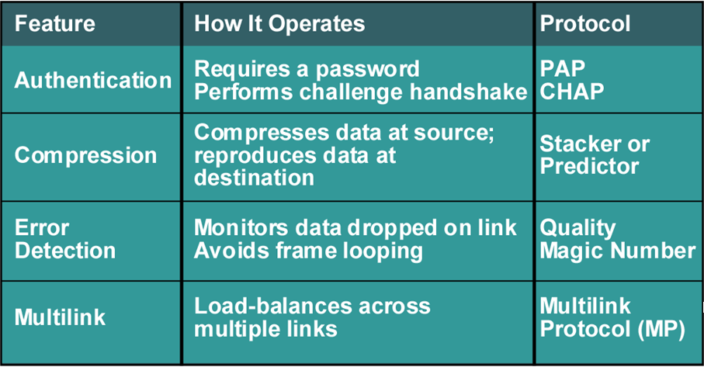
PPP LCP Configuration Options

Slide 8
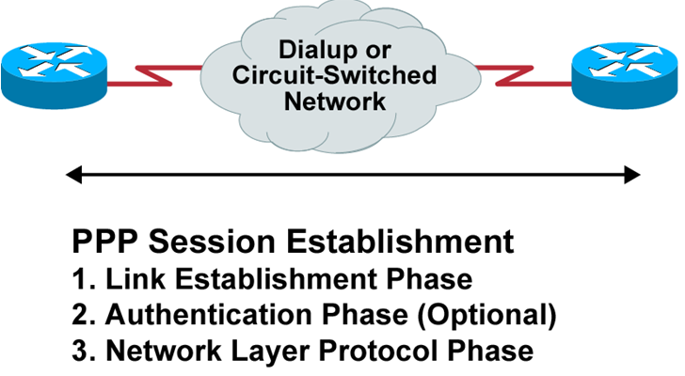
PPP Session Establishment
Two PPP authentication protocols:
PAP and CHAP

Slide 9
PPP Authentication Methods
Password Authentication Protocol (PAP)
  Passwords sent in clear text
  Remote node returns username & password
Challenge Handshake Authentication Protocol (CHAP)
  Done at start-up & periodically
  Challenge & Reply
    Remote router sends a one-way hash ~ MD5

Slide 10
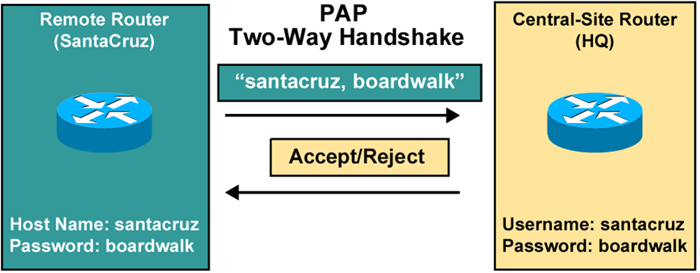
Password Authentication Protocol
Passwords sent in clear text
Peer in control of attempts

Slide 11
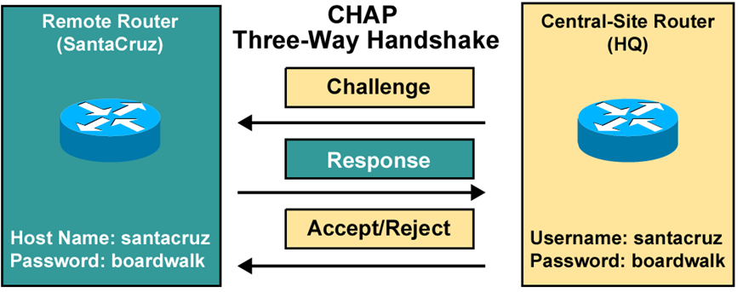
Challenge Handshake Authentication Protocol
Hash values, not actual passwords, are sent across link.
The local router or external server is in control of attempts.

Slide 12
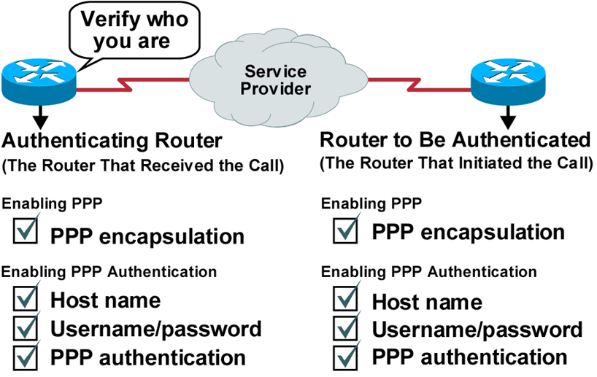
Configuring PPP and Authentication Overview

Slide 13
Configuring PPP
Router(config-if)#encapsulation ppp
Enables PPP encapsulation

Slide 14
Configuring PPP Authentication
Router(config)#hostname name
Assigns a host name to your router
Router(config)#username name password password
Identifies the username and password of remote router
Router(config-if)#ppp authentication
{chap | chap pap | pap chap | pap}
Enables PAP and/or CHAP authentication

Slide 15
Configuring PPP
Step #1: Configure PPP on RouterA & RouterB:
    Router__#config t
    Router__(config)#int s0
    Router__(config-if)#encapsulation ppp
    Router__(config-if)#^Z
Step #2: Define the username & password on each router:
  RouterA: RouterA(config)#username RouterB password cisco
  RouterB: RouterB(config)#username RouterA password cisco
  NOTE: (1) Username maps to the remote router
  (2) Passwords must match
Step #3: Choose Authentication type for each router; CHAP/PAP
  Router__(Config)#int s0
  Router__(config-if)#ppp authentication chap
  Router__(config-if)#ppp authentication pap
  Router__(config-if)#^Z

Slide 16
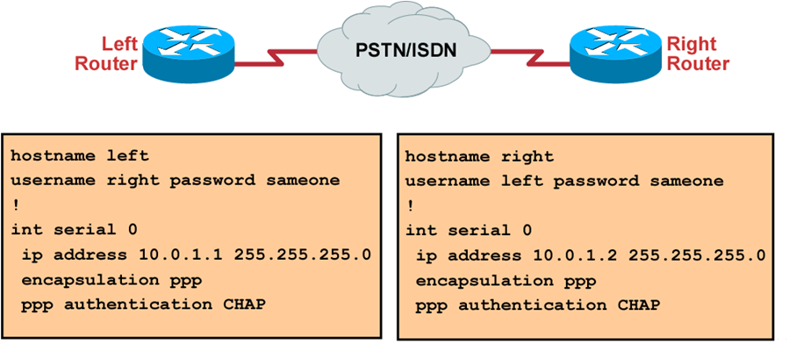
CHAP Configuration Example

Slide 17
Verifying the HDLC and PPP Encapsulation Configuration
Router#show interface s0
Serial0 is up, line protocol is up
Hardware is HD64570
Internet address is 10.140.1.2/24
MTU 1500 bytes, BW 1544 Kbit, DLY 20000 usec, rely 255/255, load 1/255
Encapsulation PPP, loopback not set, keepalive set (10 sec)
LCP Open
Open: IPCP, CDPCP
Last input 00:00:05, output 00:00:05, output hang never
Last clearing of "show interface" counters never
Queueing strategy: fifo
Output queue 0/40, 0 drops; input queue 0/75, 0 drops
5 minute input rate 0 bits/sec, 0 packets/sec
5 minute output rate 0 bits/sec, 0 packets/sec
38021 packets input, 5656110 bytes, 0 no buffer
Received 23488 broadcasts, 0 runts, 0 giants, 0 throttles
0 input errors, 0 CRC, 0 frame, 0 overrun, 0 ignored, 0 abort
38097 packets output, 2135697 bytes, 0 underruns
0 output errors, 0 collisions, 6045 interface resets
0 output buffer failures, 0 output buffers swapped out
482 carrier transitions
DCD=up DSR=up DTR=up RTS=up CTS=up

Slide 18
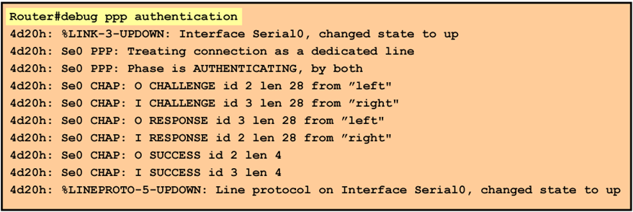
Verifying PPP Authentication
debug ppp authentication shows successful CHAP output.

